Slide 1
Thinking of and with data: How students and teachers (and researchers) use data in STEM education
Joshua M. Rosenberg, Doctoral Candidate
Michigan State University
January 24th, 2018
University of Tennessee, Knoxville
Department of Theory and Practice of Teacher Education
Notes:
Thank you to the Mehmet Aydeniz and the search committee and the faculty and students in the TPTE department as well as Ms. Gina Guinn for making this trip possible.
This talk is on work with data in STEM. In particular, this talk is focused on teachers and students - and researchers - use of data in STEM, or what I term thinking of and with data, or, as I’ll describe later, what some call data science.

Slide 2
Introduction | Overview | Study 1 | Study 2 | Future Work
Introduction
Overview
Study 1
Study 2
Future Work

Slide 3
How I came to my research interest
Introduction | Overview | Study 1 | Study 2 | Future Work
Taught H.S. Biology, Chemistry, and Earth Science
Motivated by challenges and opportunities of supporting students to do science in personally meaningful ways
Research focused on scientific modeling and used data in my work which helped me consider student use of data
Apply research to teaching about technology integration in science (and STEM) education

Slide 4
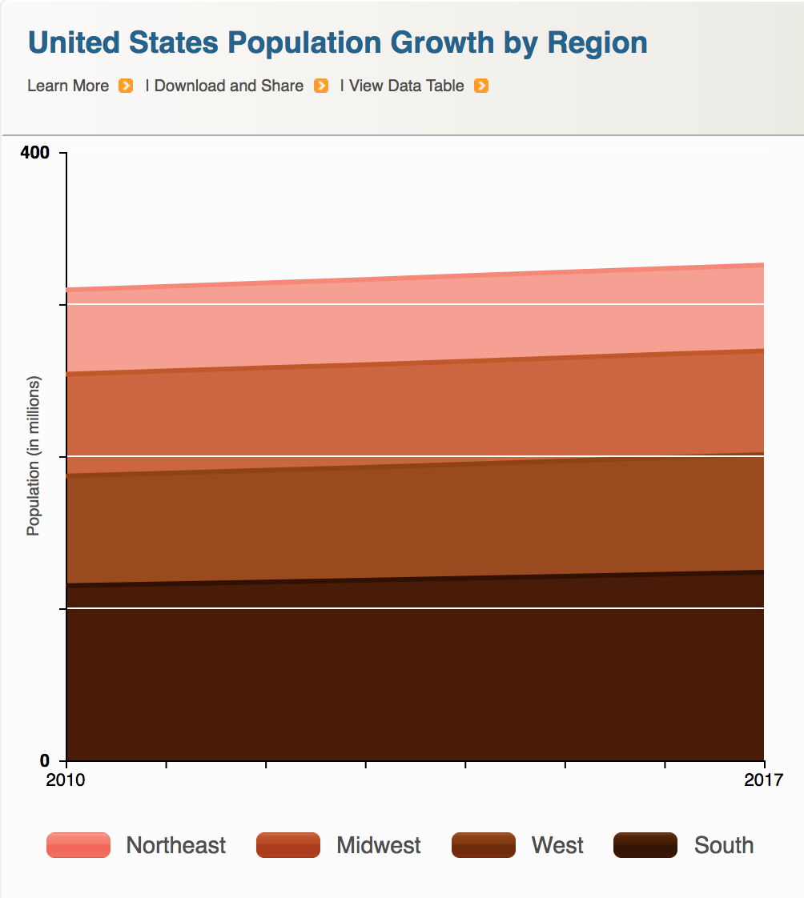
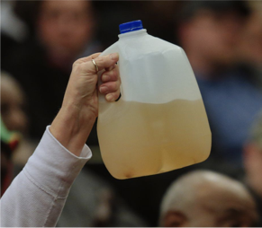

Data is power(ful)
Introduction | Overview | Study 1 | Study 2 | Future Work
Companies
Government
Citizens

Slide 5
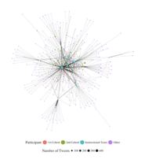
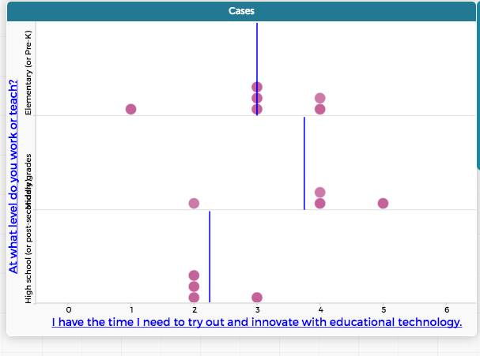
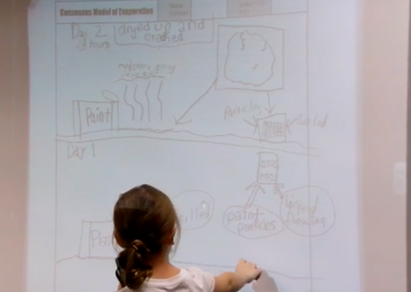
Data is power(ful)
Introduction | Overview | Study 1 | Study 2 | Future Work
Researchers
Teachers
Students

Slide 6
Work with data in K-12 education
Introduction | Overview | Study 1 | Study 2 | Future Work
Students’ Work With Data
Teachers’ Support for Work With Data

Slide 7
Work with data in K-12 education
Introduction | Overview | Study 1 | Study 2 | Future Work
Students’ Work With Data
Teachers’ Support for Work With Data
Curricular standards,
resources,
assessments,
and technological tools
Berland & McNeil, 2017
Notes:
SWITCH THE ORDER OF THOSE NAMES

Slide 8
Work with data in K-12 education
Introduction | Overview | Study 1 | Study 2 | Future Work
Researchers’ design and development of contexts for work with data
Students’ Work With Data
Teachers’ Support for Work With Data
Curricular standards,
resources,
assessments,
and technological tools
Lehrer & Schauble, 2015
Berland & McNeil, 2017

Slide 9
Work with data in K-12 education
Introduction | Overview | Study 1 | Study 2 | Future Work
Researchers’ design and development of contexts for work with data
Students’ Work With Data
Teachers’ Support for Work With Data
Curricular standards,
resources,
assessments,
and technological tools
Notes:
CHANGE TITLE TO "WORK WITH DATA IN STEM"

Slide 10
Introduction | Overview | Study 1 | Study 2 | Future Work
Introduction
Overview
Study 1
Study 2
Future Work

Slide 11
Examples of past and ongoing research
Introduction | Overview | Study 1 | Study 2 | Future Work
Students’ work with data
Teachers’ support for work with data
Researchers studying work with data

Slide 12
Students’ work with data
Introduction | Overview | Study 1 | Study 2 | Future Work
Researchers’ design and development of contexts for work with data
Students’ Work With Data
Teachers’ Support for Work With Data
Curricular standards,
resources,
assessments,
and technological tools
Notes:
As you can see, I have a lot of questions and interests about the use of data in science education research, teaching, and learning. I obviously can’t talk about all of these questions today, but I will,
Touch on some of them briefly,
And later, I’ll go into some considerable depth on one of them.

Slide 13
Questions about students’ work with data
Introduction | Overview | Study 1 | Study 2 | Future Work
How do students engage in work with data?
How do the practices described in recent science education reform efforts (e.g., the Next Generation Science Standards) provide a context for work with data?
How can students use new sources of data in their learning?
Notes:
CHANGE "...for work with data" to "for this work"

Slide 14
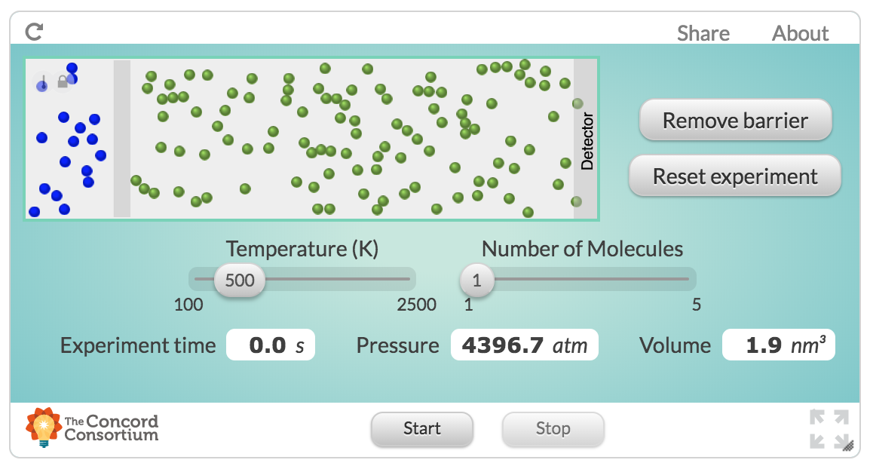
Example: Students’ use of simulations
Introduction | Overview | Study 1 | Study 2 | Future Work
How can high school students use new sources of data in their learning?
Designed a simulation and activities focused on work with data
Students accessed complex data, created a class dataset, and generated explanations for the time it took for a smell to travel across a room
Rosenberg, 2017, MVLRI RPIN

Slide 15
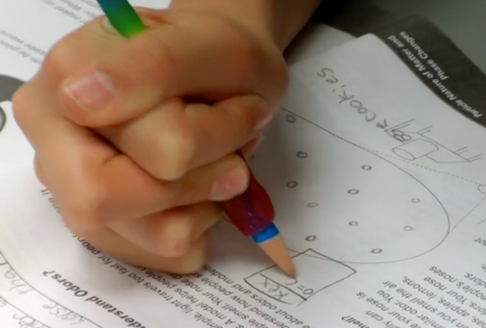
Example: Engaging in scientific practices
Introduction | Overview | Study 1 | Study 2 | Future Work
How do MS students engage in the scientific practices of modeling and explanation?
Studied considerations about the generality of their models and explanations through use of embedded assessments
Students’ advanced in their understanding of generality and modeling and explaining phenomena over three years
Rosenberg & Krist, 2016, April, NARST; Krist & Rosenberg, 2016, July, ICLS; Rosenberg & Schwarz, 2016, April, NARST
Notes:
Introduction to this - engaging in scientific practices

Slide 16
Teachers’ support for work with data
Introduction | Overview | Study 1 | Study 2 | Future Work
Students’ Work With Data
Teachers’ Support for Work With Data
Design and development of contexts for work with data
Curricular standards,
resources,
assessments,
and technological tools
Notes:
As you can see, I have a lot of questions and interests about the use of data in science education research, teaching, and learning. I obviously can’t talk about all of these questions today, but I will,
Touch on some of them briefly,
And later, I’ll go into some considerable depth on one of them.

Slide 17
Questions about teachers’ support for work with data
Introduction | Overview | Study 1 | Study 2 | Future Work
How can teachers design activities and curricula that support student work with data?
What do teachers already know and do that can provide leverage points for working with authentic sources of data?
How do different contexts (formal and informal) provide affordances to teachers and instructors for work with data?

Slide 18
Example: Teachers’ data modeling
Introduction | Overview | Study 1 | Study 2 | Future Work
What do teachers already know and do that can provide leverage points for working with authentic sources of data?
Engage in-service teachers in “data modeling” activities focused on their practice
Data modeling led to rich discussions and helped support teachers’ confidence around work with data
Rosenberg & Henriksen, in preparation

Slide 19
Example: Teachers’ use of scientific modeling
Introduction | Overview | Study 1 | Study 2 | Future Work
How do middle school science teachers’ practice and views about the use of scientific modeling change over a long period of time?
Collaborated with two teachers and documented their adaptation of modeling
Alignment with teachers’ goals and support from their administration and context sustained use of modeling
“A lot of my kids certainly still hold misconceptions, but they got rocked, too, because of the different models that we used.”
“Once you get them to share those ideas, the coolest part is seeing . . . [students] adapt and evolve those into a better understanding of what's really going on.”
Rosenberg, Schwarz, & Akcaoglu, revise and resubmit, JTE; Rosenberg, Schwarz, Lee, & Akcaoglu, 2015, NARST
Notes:
modeling: explaining phenomena by iteratively constructing, evaluating, and revising models
models: “specialized representations that simplify systems…to illustrate, explain, and predict phenomena”
(Schwarz et al., 2009, p. 634)

Slide 20
Researchers’ study of work with data
Introduction | Overview | Study 1 | Study 2 | Future Work
Researchers’ design and development of contexts for work with data
Students’ Work With Data
Teachers’ Support for Work With Data
Curricular standards,
resources,
assessments,
and technological tools
Notes:
As you can see, I have a lot of questions and interests about the use of data in science education research, teaching, and learning. I obviously can’t talk about all of these questions today, but I will,
Touch on some of them briefly,
And later, I’ll go into some considerable depth on one of them.

Slide 21
Researchers’ study of work with data
Introduction | Overview | Study 1 | Study 2 | Future Work
How can researchers study engagement in scientific and engineering practices?
How can researchers study authentic artifacts created by teachers and students?
What contexts are needed to support work with data?

Slide 22
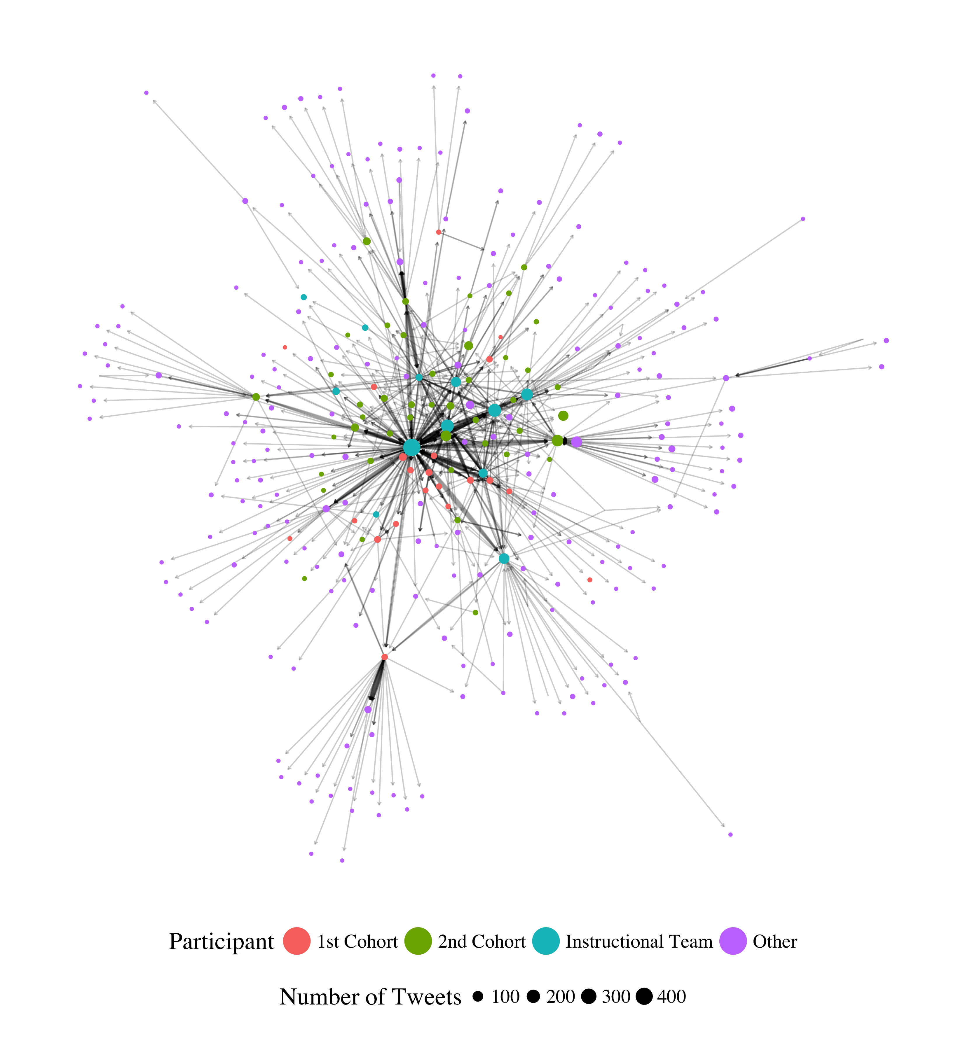
Example: Development of communities on Twitter
Introduction | Overview | Study 1 | Study 2 | Future Work
How can social media tools and social network analysis help us to understand teachers’ professional learning networks?
Studied development of community in a graduate certificate program
Examined the types of interactions community members have and how to portray those connections
Rosenberg, Greenhalgh, Wolf, & Koehler, 2017, JCMST; Rosenberg, Greenhalgh, Koehler, Hamilton, & Akcaoglu, 2016, EDM

Slide 23

Example: Analysis of digital portfolios as performance assessments
Introduction | Overview | Study 1 | Study 2 | Future Work
How can researchers study authentic artifacts as measures of teachers’ technological understanding?
Studies teachers’ Technological Pedagogical Content Knowledge (TPACK) through digital portfolios created for MA degree programs
Found that portfolios could be used to understand teachers’ TPACK
Koehler, Greenhalgh, Rosenberg, & Keenan, 2016, JTATE; Rosenberg & Koehler, 2015, JRTE

Slide 24
Introduction | Overview | Study 1 | Study 2 | Future Work
Introduction
Overview
Study 1
Study 2
Future Work

Slide 25
How do K-12 students who work with data in science education engage in their learning?
Introduction | Overview | Study 1 | Study 2 | Future Work
Study 1: How do specific activities and students’ ability to make choices about their learning impact their engagement in high school science classes?
Study 2: How does work with data impact the engagement of youth at the middle grades level in summer STEM programs?
Notes:
REMOVE "TWO STUDIES TO EXPLORE THIS ISSIE"
REWORD STUDY 1 and STUDY 2

Slide 26

Work with data in K-12 education
Introduction | Overview | Study 1 | Study 2 | Future Work

Slide 27
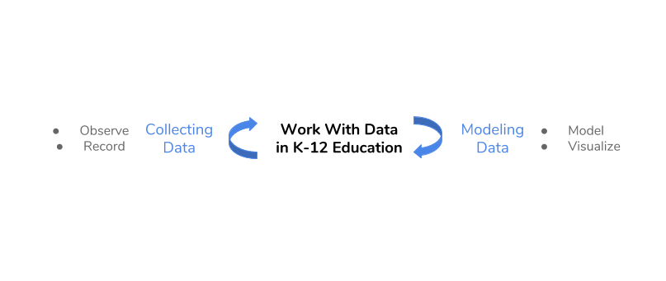
Work with data in K-12 education
Introduction | Overview | Study 1 | Study 2 | Future Work
Hancock, Kaput, & Goldsmith, 1992; Wild & Pfannkuch, 1999

Slide 28
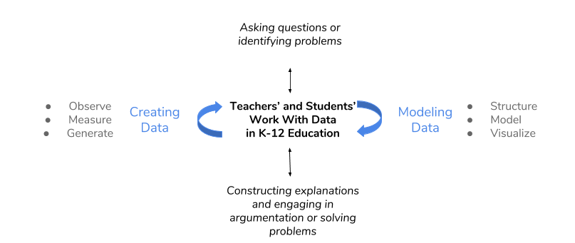
Work with data in K-12 education
Introduction | Overview | Study 1 | Study 2 | Future Work
NGSS Lead States, 2013; National Research Council, 2012

Slide 29
Study 1
Introduction | Overview | Study 1 | Study 2 | Future Work
How do specific activities and students’ ability to make choices about their learning impact their engagement in high school science classes?
Explored common and hands-on science activities using a person-in-context approach
Explored how different choices (such as about how to do the activity or with whom to work) impacted students’ engagement
Schmidt, Rosenberg, & Beymer, 2018, JRST

Slide 30
Context and sample
Introduction | Overview | Study 1 | Study 2 | Future Work
12 high school classrooms
Physics, Chemistry, Biology, and Integrated Science
Large high school outside of a metropolitan area in the Midwest United States
244 students
From racially and ethnically diverse groups
Notes:
Sample: 42% Hispanic, 37% White, 12% Black, 9% Multi-racial and from other groups)

Slide 31
Experience sampling method (ESM)
Introduction | Overview | Study 1 | Study 2 | Future Work
Involves asking participating students / youth about their experiences using short surveys
Typically using a mobile device (app on a phone)
Every 15-30 minutes
Took 1-2 minutes to complete
“When you were signaled, how interested were you in what you were learning?”

Slide 32
Why ESM?
Introduction | Overview | Study 1 | Study 2 | Future Work
Understand learning experiences in a qualitatively distinct way (Hektner, Schmidt, & Csikszentmihalyi, 2007)
Helps us to understand moment-to-moment changes in learning
Understand experiences during activities such as laboratories
Can investigate engagement in a context-sensitive way

Slide 33
Dimensions of engagement
Introduction | Overview | Study 1 | Study 2 | Future Work
Cognitive engagement: Importance to self
Affective engagement: Enjoyment of activity
Behavioral engagement: Effort exerted
Notes:
Psychological and motivational investment in learning activities

Slide 34
Person-oriented approach
Introduction | Overview | Study 1 | Study 2 | Future Work
How students experience engagement together and at once
Two-step cluster analysis via prcr (Rosenberg, Schmidt, Beymer, & Steingut, 2018)
Interpreted solutions on the basis of fit indices, cross-validation, and concerns of parsimony and interpretability

Slide 35
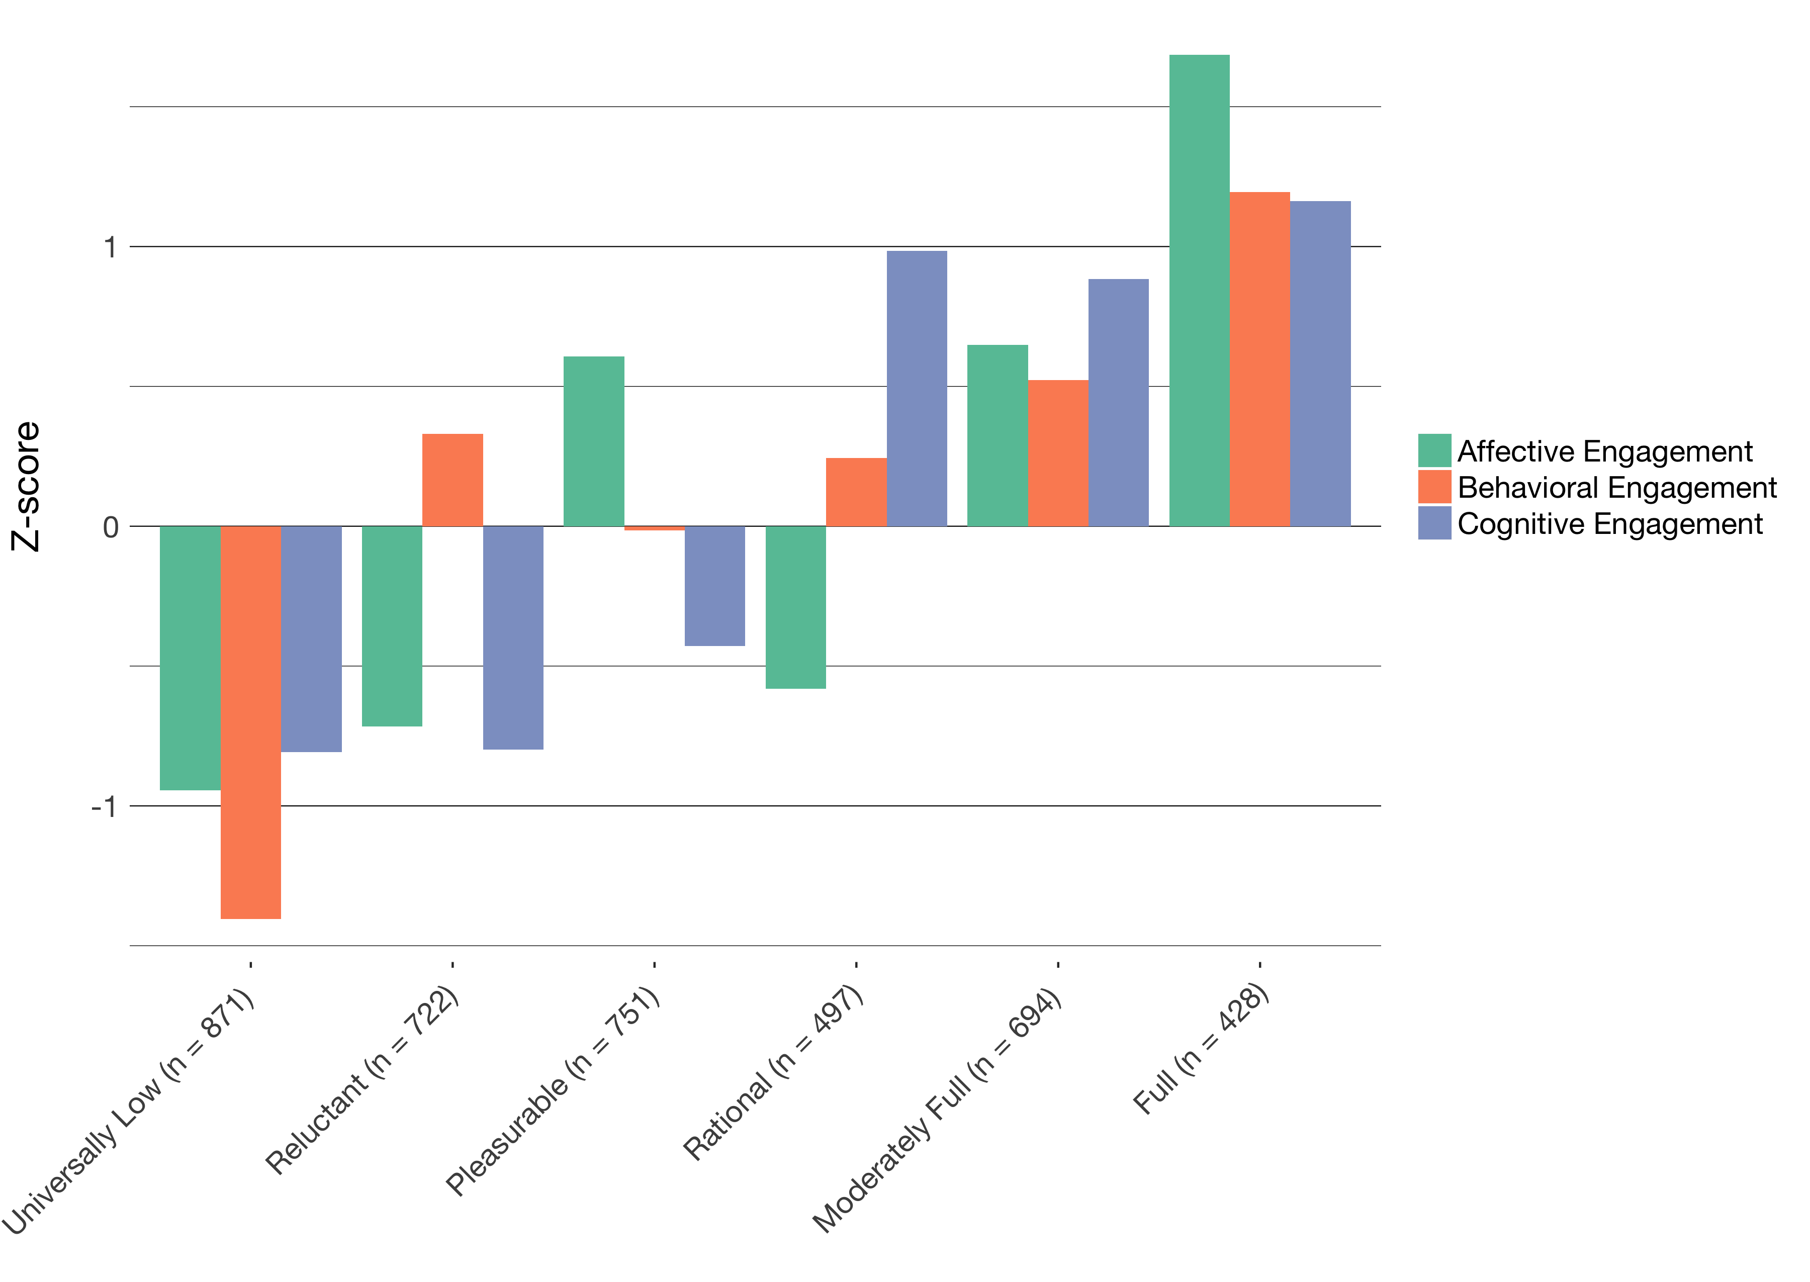
Profiles of engagement
Introduction | Overview | Study 1 | Study 2 | Future Work

Slide 36
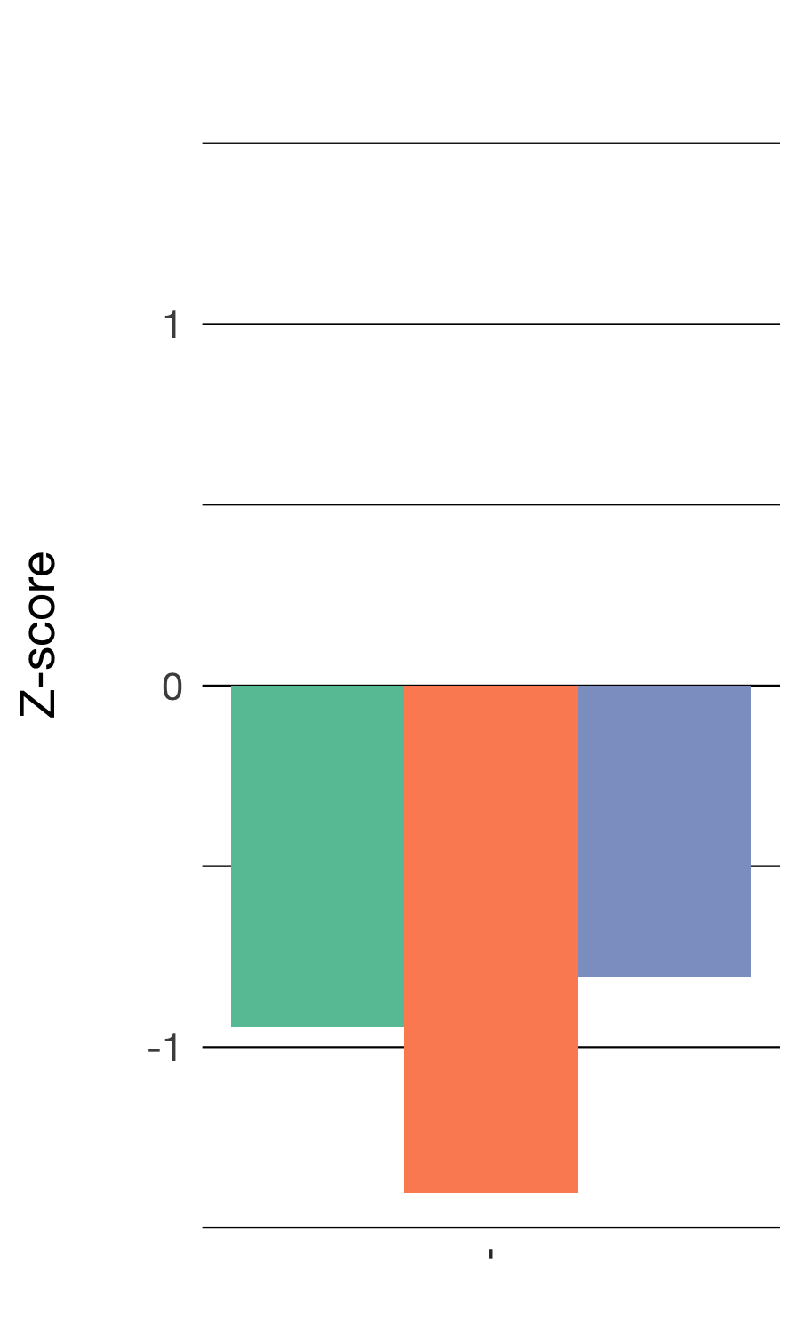
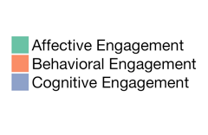
Universally Low
Introduction | Overview | Study 1 | Study 2 | Future Work
Low levels of all three dimensions of engagement
871 responses

Slide 37
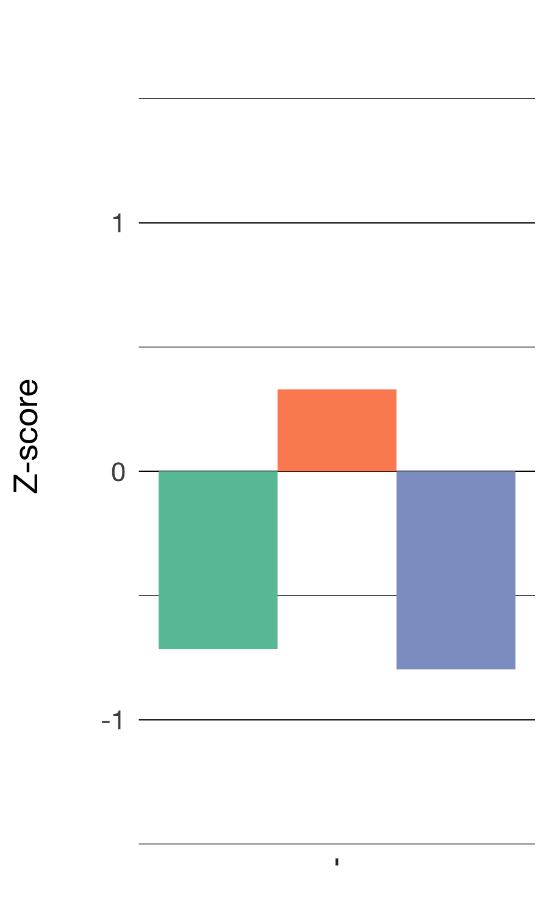
Reluctant
Introduction | Overview | Study 1 | Study 2 | Future Work
Modest levels of effort paired with low enjoyment and importance
722 responses

Slide 38
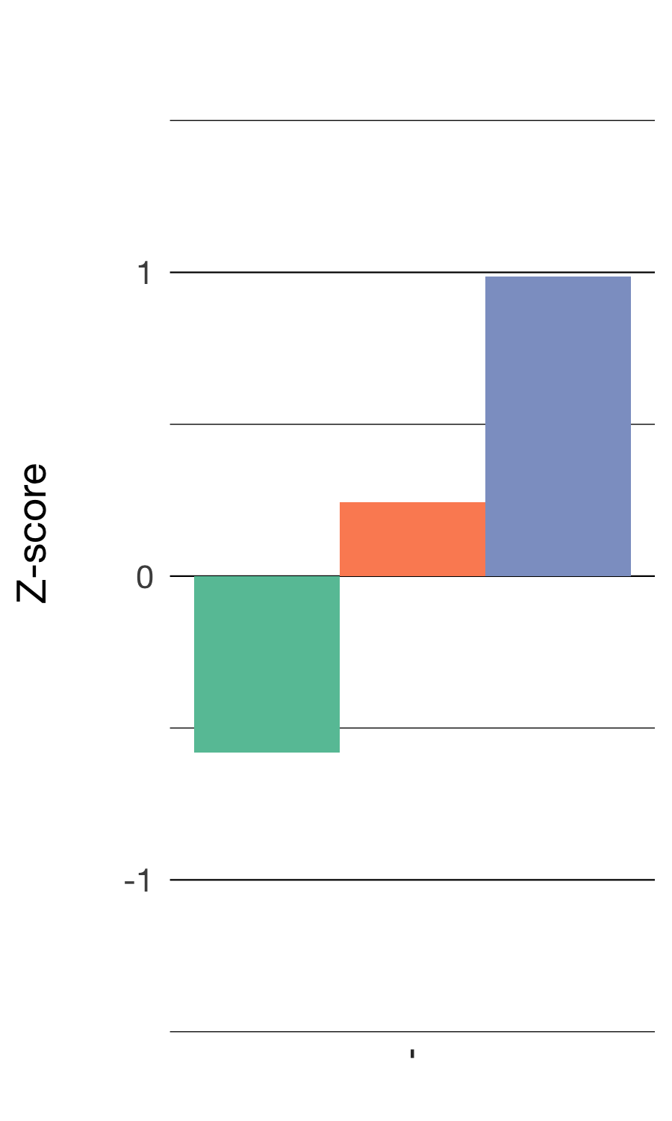
Rational
Introduction | Overview | Study 1 | Study 2 | Future Work
High cognitive engagement, modest behavioral engagement, and low affective engagement
491 responses

Slide 39
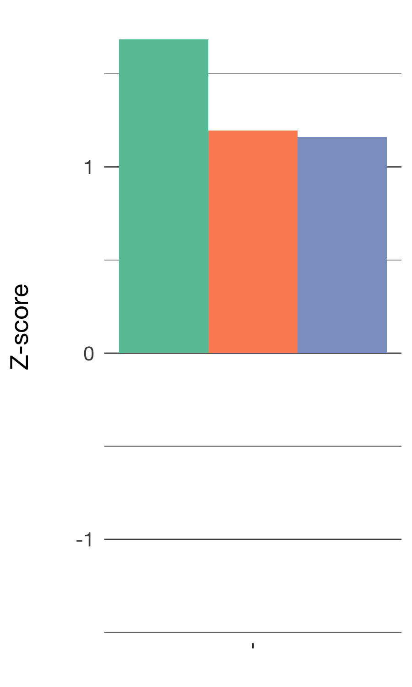
Full
Introduction | Overview | Study 1 | Study 2 | Future Work
High enjoyment, effort, and importance
428 responses

Slide 40
Profiles of engagement
Introduction | Overview | Study 1 | Study 2 | Future Work

Slide 41
Different activities are associated with different profiles of engagement
Introduction | Overview | Study 1 | Study 2 | Future Work
Laboratory activities are associated with Full engagement (Z = 3.93, p < .001) and Universally Low engagement (Z = 3.62, p < .001)
Quizzes and tests have some affordances in terms of students’ Rational engagement (Z = 12.62, p < .001)
Individual work is associated with Reluctant engagement (Z = 3.72, p < .001)
χ² = 339.16 (20), p < .001

Slide 42
The impacts of choice on engagement
Introduction | Overview | Study 1 | Study 2 | Future Work
Being able to make any choice is associated with Full engagement (Z = 4.49, p < .001) and less Universally Low engagement (Z = -3.85, p < .001)
Choosing with whom to work with is associated with Universally Low engagement (β = 1.43, p < .001)
Choosing the purpose or topic (β = 1.60, p < .001) and choosing how to do the activity (β = 1.35, p < .05) is associated with Full engagement

Slide 43
The impacts of choice during laboratory
Introduction | Overview | Study 1 | Study 2 | Future Work
During laboratory, when students were able to make any choice (who, materials, time, how to do, framing, or other):
They are more likely to be fully engaged (z = 3.90, p < .05), which is not the case when they report no choice (z = -.23)

Slide 44
Summary
Introduction | Overview | Study 1 | Study 2 | Future Work
Use of ESM allowed us to study the impacts of specific learning activities and choices
Different activities, specifically laboratory activities, are associated with potentially adaptive profiles of engagement in science
Providing opportunities for students to decide what to do or how to do it can impact students’ engagement in science

Slide 45
Implications for teachers and teacher educators
Introduction | Overview | Study 1 | Study 2 | Future Work
For teachers: Carry out a range of activities to engage students, knowing some activities afford certain kinds of engagement more than others
Laboratory activities have great potential but how they are carried out matters
For teacher educators and teacher education: Help teachers notice and provide opportunities for students to make different choice

Slide 46
Introduction | Overview | Study 1 | Study 2 | Future Work
Introduction
Overview
Study 1
Study 2
Future Work

Slide 47
Study 2
Introduction | Overview | Study 1 | Study 2 | Future Work
How does work with data impact the engagement of youth at the middle grades level in summer STEM programs?
Focused specifically on work with data
Profiles of engagement and its conditions included of students’ self-beliefs about the activity and themselves
Summer STEM programs designed around best practices

Slide 48
Context and sample
Introduction | Overview | Study 1 | Study 2 | Future Work
Nine summer STEM programs
Science-focused
Mathematics-focused
Engineering-focused
Offered by two intermediary organizations responsible for coordinating programs and their curricula
203 students
From racially and ethnically diverse groups
Notes:
(48% Hispanic, 36% Black, 7% Asian / Pacific Islander, 6% White, 3% Multi-racial)

Slide 49
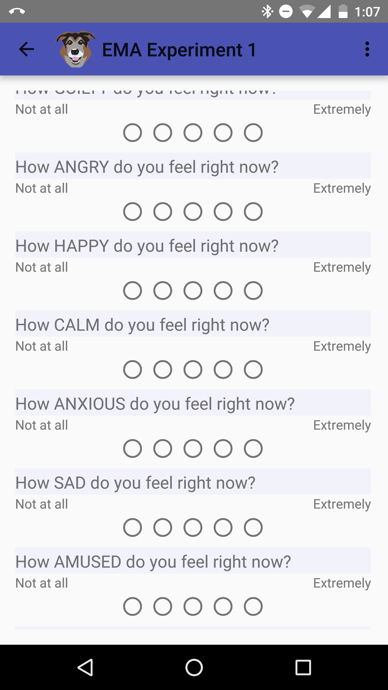
Experience sampling method (ESM)
Introduction | Overview | Study 1 | Study 2 | Future Work
Notes:
Like the previous study, the data we used to answer this question was ESM.

Slide 50
Coding frame for teacher support for data practices
Introduction | Overview | Study 1 | Study 2 | Future Work
Teacher Support for Data Practice | Description
Asking questions or defining problems | Discussing and exploring topics to investigate and pose questions.
Making observations | Watching and noticing what is happening with respect to the phenomena or problem being investigated.
Generating data | Figuring out how or why to record an observation as data and generating coding frames or measurement tools.
Data modeling | Understanding and explaining phenomena using models of the data that account for variability or uncertainty.
Interpreting and communicating findings | Discussing and sharing and presenting findings.
Notes:
shorten

Slide 51
Engagement and its conditions
Introduction | Overview | Study 1 | Study 2 | Future Work
Cognitive engagement: Was learning something new
Affective engagement: Enjoyment of activity
Behavioral engagement: Effort exerted
Challenge: Perceptions of how challenging the activity was
Competence: Perceptions of how good at an activity one was

Slide 52
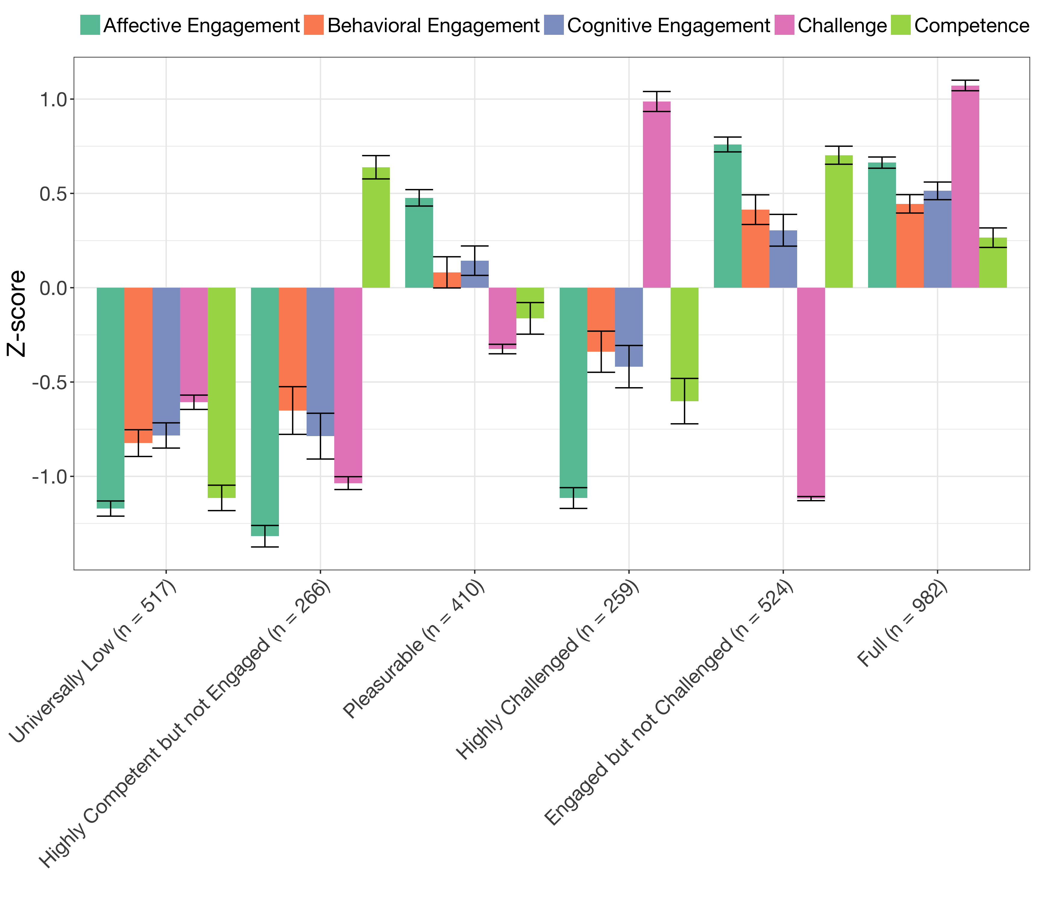
Profiles of engagement and its conditions
Introduction | Overview | Study 1 | Study 2 | Future Work

Slide 53
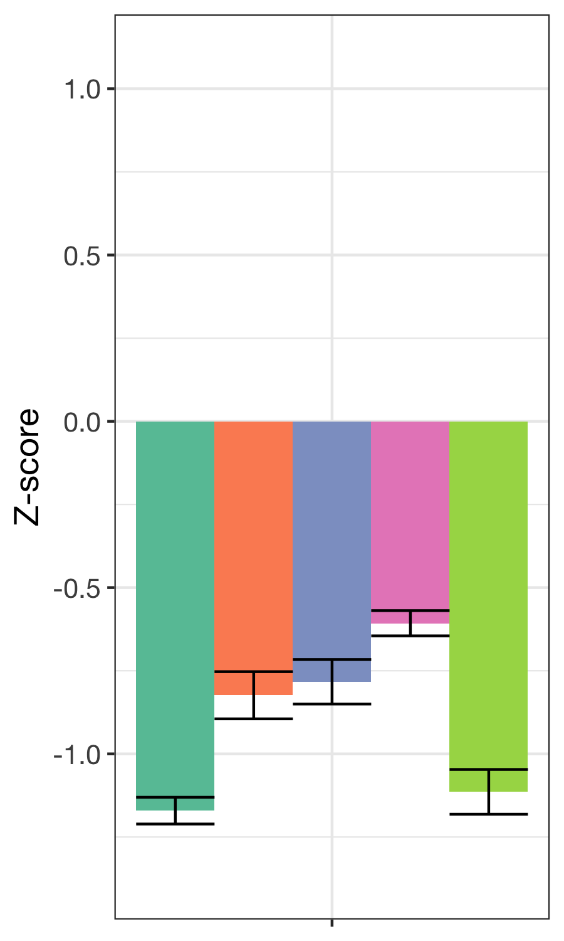
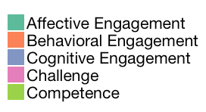
Universally low
Introduction | Overview | Study 1 | Study 2 | Future Work
Low levels of engagement and its conditions
571 responses

Slide 54
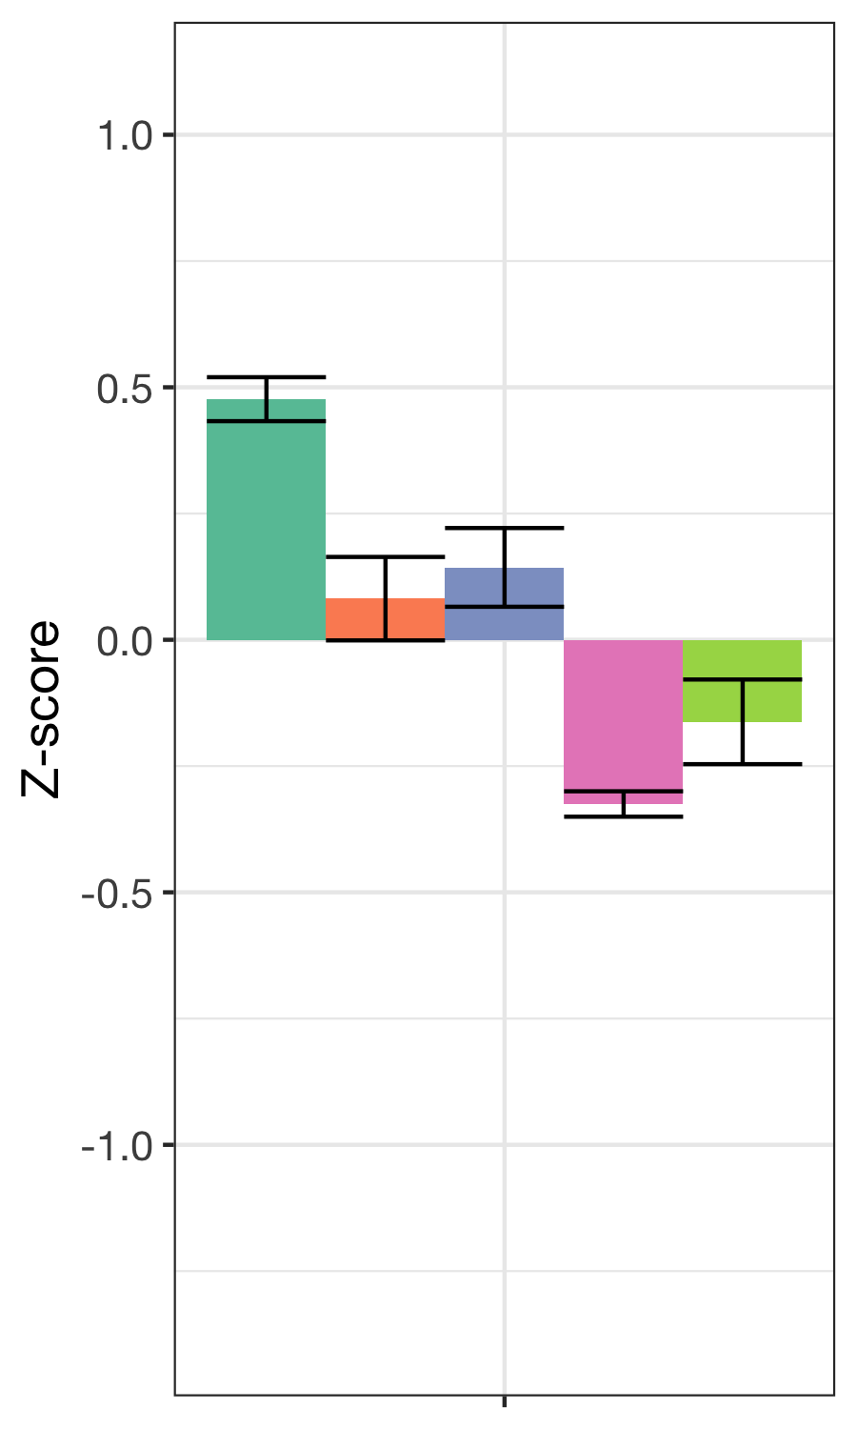
Pleasurable
Introduction | Overview | Study 1 | Study 2 | Future Work
Moderately high enjoyment, moderate effort and learning, and moderately low challenge and competence
410 responses

Slide 55
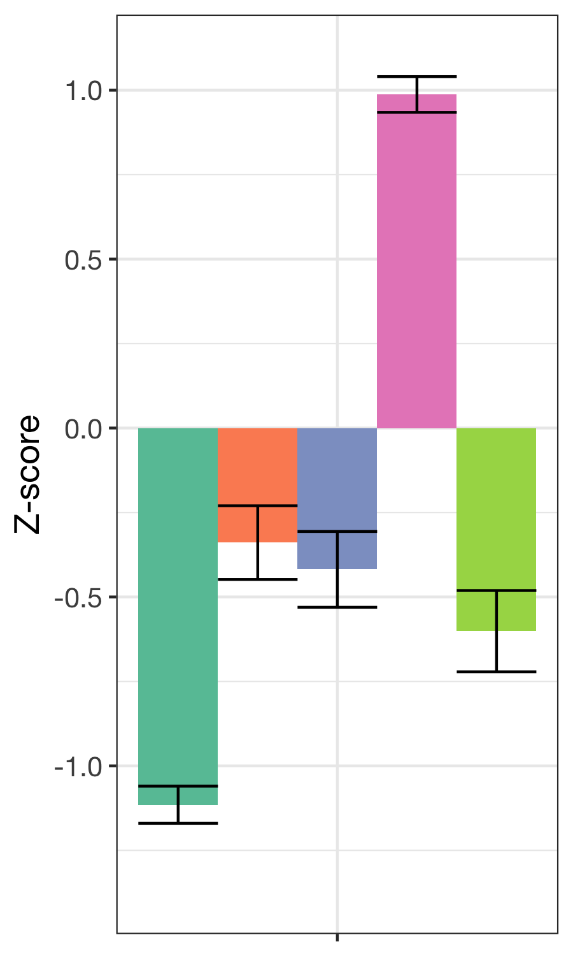
Highly challenged and disengaged
Introduction | Overview | Study 1 | Study 2 | Future Work
High challenge, low enjoyment, moderately low effort and learning, and low competence
259 responses

Slide 56
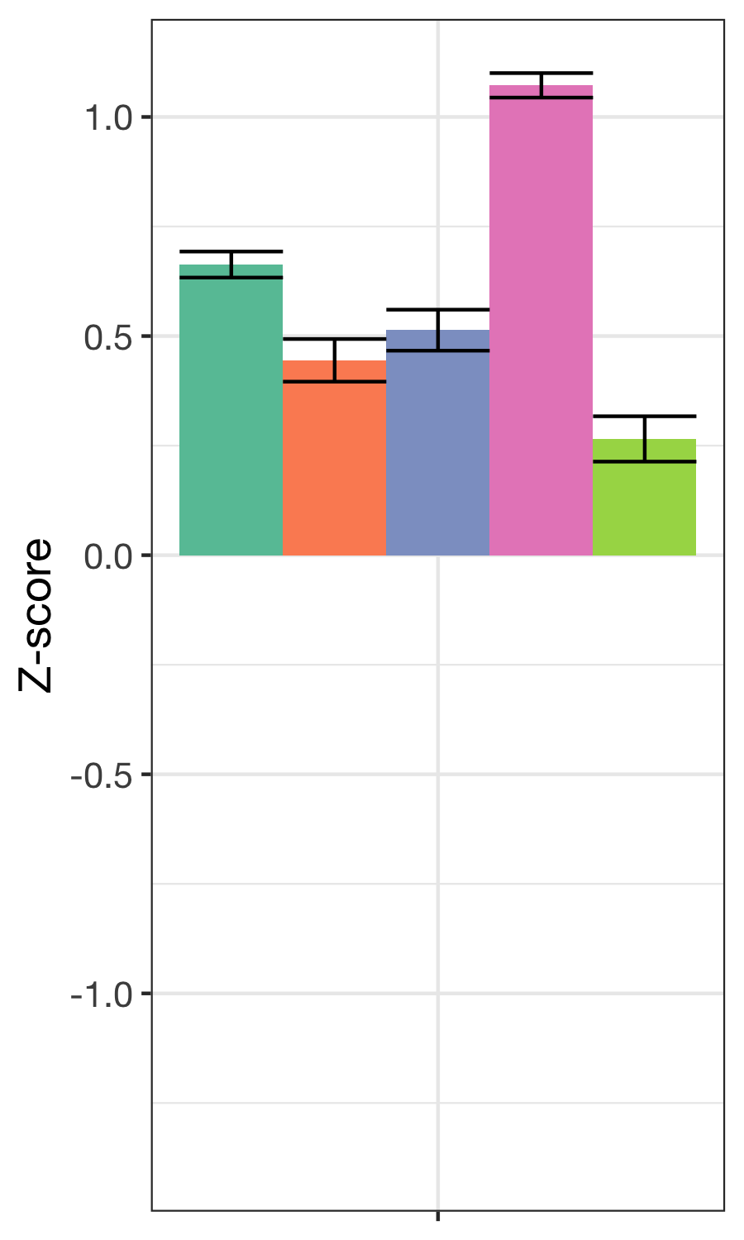
Full
Introduction | Overview | Study 1 | Study 2 | Future Work
High challenge and enjoyment and learning, moderate effort, and moderate competence
982 responses

Slide 57
Profiles of engagement and its conditions
Introduction | Overview | Study 1 | Study 2 | Future Work

Slide 58
Quantitative findings: Engagement in data practices
Introduction | Overview | Study 1 | Study 2 | Future Work
Use of generalized linear mixed effects models (HLM)
When students report being Fully engaged:
When students are generating data relative to not working with data, they are more likely to be fully engaged (β = 1.395, p = .029)
and less likely to be observing phenomena (β = 0.410, p = .028)

Slide 59
Qualitative findings: Engagement in data practices
Introduction | Overview | Study 1 | Study 2 | Future Work
Generating data not very common in ways envisioned in recent reform efforts
Affordances of different subject areas for different aspects of work with data:
Making observations (science)
Generating data (engineering)
Analyzing data (mathematics)
Models are frequently created by others (authoritative sources), instead of students

Slide 60
Summary
Introduction | Overview | Study 1 | Study 2 | Future Work
ESM helped us understand how specific activities, such as generating data, relate to work with data engage learners
Difficulty linking data creation to data modeling as part of one investigation
Summer STEM programs have affordances and constraints for work with data

Slide 61
Implications for teachers and teacher educators
Introduction | Overview | Study 1 | Study 2 | Future Work
Generating data is an important and engaging step in work with data
Inscriptions serve commitments
Fostering a complete cycle of investigation can be hard
Modeling data is not very common (although other types of modeling are)

Slide 62
Findings from across both studies
Introduction | Overview | Study 1 | Study 2 | Future Work
As students move from activity to activity, their engagement can change
Engagement seems to be different when we consider its conditions, perceptions of challenge and competence
Engagement seems to be different across contexts (high school classrooms and summer STEM programs)
Certain general activities and activities related to work with data, and certain choices, are associated with adaptive profiles of engagement
Notes:
ADD WHAT WE KNOW ABOUT FEATURES OF EFFECTIVE STEM LEARNING ENVIRONMENTS

Slide 63
Introduction | Overview | Study 1 | Study 2 | Future Work
Introduction
Overview
Study 1
Study 2
Future Work

Slide 64
Research focused on work with data
Introduction | Overview | Study 1 | Study 2 | Future Work
Researchers’ design and development of contexts for work with data
Students’ Work With Data
Teachers’ Support for Work With Data
Curricular standards,
resources,
assessments,
and technological tools

Slide 65
Research focused on work with data
Introduction | Overview | Study 1 | Study 2 | Future Work
Researchers’ design and development of contexts for work with data
Students’ Work With Data
Teachers’ Support for Work With Data
Curricular standards,
resources,
assessments,
and technological tools
Notes:
Students’ work with data:
Changes in students’ learning and motivation
Doing “data science”
Teachers’ support for work with data:
Building teachers’ capacity to work with data
Supporting teachers to carry out data-intensive activities
Researchers’ studying work with data:
Fostering leadership through networks
Building on strengths of TPTE’s courses

Slide 66
Changes in students’ learning and motivation
Introduction | Overview | Study 1 | Study 2 | Future Work
How engaging in specific aspects of work with data lead to changes in interest and future plans in science
Use of HLM to explore before-to-after changes from involvement in summer STEM programs as a result of engagement
Explore how pre-program choices impact students’ experiences and their learning and motivation
Rosenberg, Beymer, & Schmidt, 2018, AERA; Beymer, Rosenberg, & Schmidt, JYA, 2018
Notes:
Explore how work with in mathematics and engineering classes allows learners to more deeply engage in science as part of a positive “feedback loop”

Slide 67
Doing “data science”
Introduction | Overview | Study 1 | Study 2 | Future Work
Designing activities and tools for doing “data science”
Accessing and processing digital sources of data
Expand opportunities to engage in engineering practices and connections to computing and CS education
Use of technological tools, i.e. tools for work with data and computational simulations
Sources I will target: NSF DRK-12 and I-TEST

Slide 68
Building teachers’ capacity to work with data
Introduction | Overview | Study 1 | Study 2 | Future Work
Engage teachers in coursework and research experiences to work with data
Support teachers to do data modeling focused around curriculum
Teachers’ designing and developing curricula and tools (i.e., support TPACK)

Slide 69
Support teachers to do data-intensive work
Organize coursework and professional development around data-intensive investigations:
Focus work with data on problems of practice and both creating and modeling data
Role of authentic work with data in content area courses
Opportunities to collaborate in TPTE and across departments

Slide 70
Fostering leadership through networks
Introduction | Overview | Study 1 | Study 2 | Future Work
Explore how teacher, curriculum director, and administrator influence on diffusion of innovations
Online (i.e., social media) and technology-enriched professional development
Build network of support for STEM learning and work with data across Knox County Schools
Sources I will target: Partners in area districts and foundation funding soruces
Notes:
Change underlined part to sources I will target

Slide 71
Building on strengths of TPTE’s courses
Introduction | Overview | Study 1 | Study 2 | Future Work
Engage teachers at the undergraduate and graduate levels:
Use of computational tools (simulation and modeling)
Work with data as cross-cutting capabilities in STEM
Design and development of technologies and support of system-wide changes:
Inquiry-, project-, and practice-based science education
Uses of social media and connection to wider audiences
Notes:
remove dashes

Slide 72
References
Introduction | Overview | Study 1 | Study 2 | Future Work
Beymer, P. N., Rosenberg, J. M., Schmidt, J. A., & Naftzger, N. (in press). Examining relationships between choice, affect, and engagement in out-of-school time STEM programs. Journal of Youth and Adolescence.
Cobb, P., Confrey, J., diSessa, A., Lehrer, R., & Schauble, L. (2003). Design experiments in educational research. Educational Researcher, 32 (1), 9-13.
Hancock, C., Kaput, J. J., & Goldsmith, L. T. (1992). Authentic inquiry with data: Critical barriers to classroom implementation. Educational Psychologist, 27(3), 337-364.
Keenan, S., Rosenberg, J. M., Greenhalgh, S. P. & Koehler, M. J. (2016). Examining teachers’ technology use through digital portfolios. In Proceedings of Society for Information Technology & Teacher Education International Conference 2016 (pp. 1084-1091). Chesapeake, VA: Association for the Advancement of Computing in Education (AACE). Retrieved from http://www.editlib.org/p/171824
Koehler, M. J., Greenhalgh, S. P., Rosenberg, M. J., & Keenan, S. (2017). What the tech is going on with digital teaching portfolios? Using the TPACK framework to analyze teachers’ technological understanding. Journal of Technology and Teacher Education, 25, 31-59. http://www.learntechlib.org/p/173346/
Krist, C., & Rosenberg, J. M. (2016). Finding patterns in and refining characterizations of students’ epistemic cognition: A computational approach. In Looi, C.-K., Polman, J., Cress, U., & Reimann, P. (Eds.), Transforming Learning, Empowering Learners: The International Conference of the Learning Sciences Proceedings 2016 (Vol. 2, pp. 1223-1224). Singapore, Singapore: ICLS.
Lehrer, R. & Schauble, L. (2015). Developing scientific thinking. In L. S. Liben & U. Müller (Eds.), Cognitive processes. Handbook of child psychology and developmental science (Vol. 2, 7th ed., pp. 671-174). Hoboken, NJ: Wiley.
McNeill, K. L., & Berland, L. (2017). What is (or should be) scientific evidence use in k‐12 classrooms? Journal of Research in Science Teaching, 54(5), 672-689.
National Research Council. (2012). A framework for K-12 science education: Practices, crosscutting concepts, and core ideas. Washington, DC: The National Academies Press.
NGSS Lead States. (2013). Next generation science standards: For states, by states. Washington, DC: National Academies Press.
Rosenberg, J. M. (2017). Opportunities for engaging students in “data practices” in online science classes. Michigan Virtual Learning Research Institute Blog: Research, Policy, Innovation & Networks. https://mvlri.org/blog/opportunities-engaging-students-data-practices-online-science-classes/
Rosenberg, J. M. & Henriksen, D., (in preparation). Teachers’ data modeling as part of a teacher education research methods course.
Notes:
Demonstrate how data can be used to empower teachers and students.

Slide 73
References
Introduction | Overview | Study 1 | Study 2 | Future Work
Rosenberg, J. M. & Krist, C. (2016, April). Characterizing students' epistemic considerations: An automated computational approach for embedded assessment responses. Poster presented at the National Association for Research in Science Teaching Annual International Conference, Baltimore, MD
Rosenberg, J. M. & Schwarz, C. V. (2016, April). Examining fifth and sixth grade students’ epistemic considerations through an automated analysis of embedded assessment items. In B. Reiser (Chair), Longitudinal studies of elementary and middle school students’ epistemic considerations through participation in scientific practice. Related paper set presented at the National Association for Research in Science Teaching Annual International Conference, Baltimore, MD.
Rosenberg, J. M., & Ranellucci, J. (2017). Student motivation in online science courses: A path to spending more time on course and higher achievement. Michigan Virtual Learning Research Institute Blog: Research, Policy, Innovation & Networks. Retrieved from https://mvlri.org/blog/student-motivation-in-online-science-courses-a-path-to-spending-more-time-on-course-and-higher-achievement/
Rosenberg, J. M., Greenhalgh, S. P., & Wolf, L. G. (2016, October). Participating from near and far: Analyzing online graduate learning communities with social network analysis. Paper presented at the Association for Educational Communications and Technology International Convention 2016, Las Vegas, NV.
Rosenberg, J. M., Schwarz, C. V., & Akcaoglu, M. (under review). A comparative longitidunal case study of two fifth-grade teachers’ engagement in scientific modeling pedagogical practice. Journal of Teacher Education.
Rosenberg, J. M., Schwarz, C. V., & Lee, S. W.-Y. , & Akcaoglu, M. (2015, April). A comparative longitudinal case study of the use of scientific modeling in the pedagogical practice of two fifth-grade science teachers. In A. Lo (Chair), Leveraging the epistemic dimensions of scientific practice to support student's meaningful engagement in modeling. Related paper set presented at the National Association for Research in Science Teaching Annual International Conference, Chicago, IL.
Rosenberg, J.M., Greenhalgh, S.P., Graves Wolf, L. & Koehler, M.J. (2017). Strategies, use, and impact of social media for supporting teacher community within professional development: The case of one urban STEM program. Journal of Computers in Mathematics and Science Teaching, 36(3), 255-267. http://www.learntechlib.org/p/180387/
Schmidt, J. A., Rosenberg, J. M., & Beymer, P. (2018). A person-in-context approach to student engagement in science: Examining learning activities and choice. Journal of Research in Science Teaching, 55(1), 19-43. https://dx.doi.org/10.1002/tea.21409
Schmidt, J. A., Rosenberg, J. M., & Beymer, P. (2018). A person-in-context approach to student engagement in science: Examining learning activities and choice. Journal of Research in Science Teaching, 55(1), 19-43. https://dx.doi.org/10.1002/tea.21409
Wild, C. J., & Pfannkuch, M. (1999). Statistical thinking in empirical enquiry. International Statistical Review, 67(3), 223-248.
Notes:
Demonstrate how data can be used to empower teachers and students.

Slide 74
Research focused on work with data
Introduction | Overview | Study 1 | Study 2 | Future Work
Researchers’ design and development of contexts for work with data
Students’ Work With Data
Teachers’ Support for Work With Data
Curricular standards,
resources,
assessments,
and technological tools
Notes:
Move this to the next slide

Slide 75

Introduction | Overview | Study 1 | Study 2 | Future Work
Thank you!
Joshua Rosenberg jrosen@msu.edu
http://jmichaelrosenberg.com
@jrosenberg6432
Michigan State University
Thank you to participating teachers and students!
Thank you to the following organizations for supporting this research:
Michigan Virtual Learning Research Institute and Michigan Virtual School
The Concord Consortium
Michigan State University
The National Science Foundation
Notes:
Demonstrate how data can be used to empower teachers and students.

Slide 76
OTHER SLIDES

Slide 77
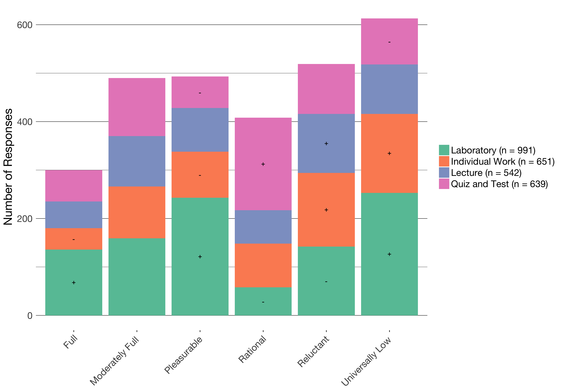

Slide 78
 | Universally Low | Reluctant | Pleasurable | Rational | Moderately Full | Full
Who | 1.43 *** | 1.19 | 1.00 | .35 *** | .44 | 1.20
Time | .38 *** | 0.47 | 0.49 | 1.82 *** | 1.26 | 0.47
How to Do | .45 | 1.07 | 0.48 | 0.46 | 1.14 | 1.35 *
Framing | .44 * | 0.46 | 0.48 | 1.14 | 1.06 | 1.60 ***

Slide 79
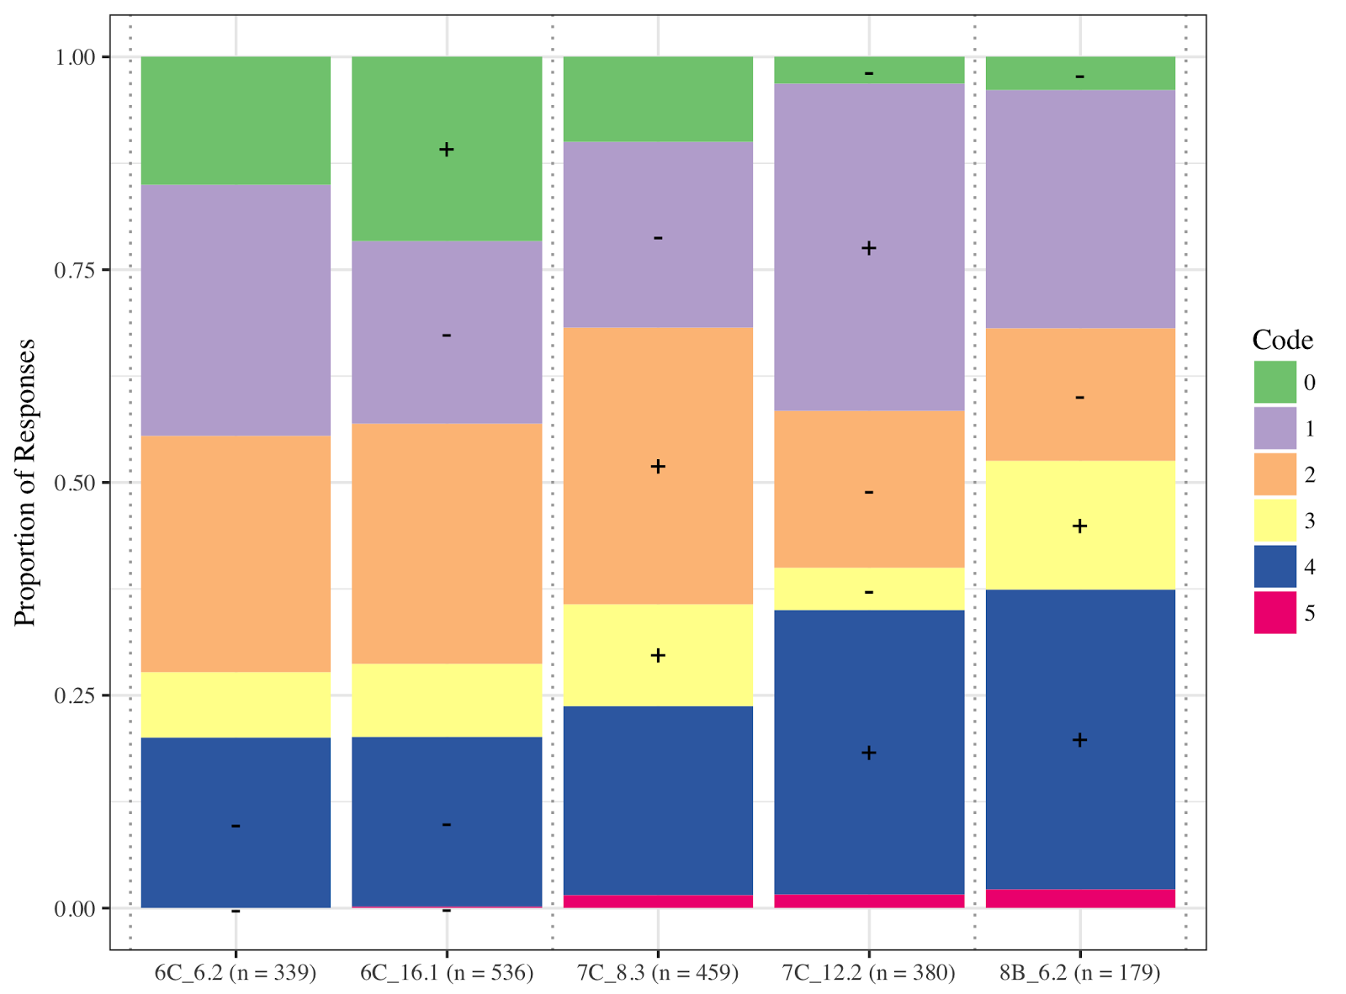
Changes in generality

Slide 80
